Slide 1
Debugging and Error Handling

Slide 2
Credits
Some of the contents of this slide presentation have been referenced and reproduced from the textbook for this course, JavaScript (Sixth Edition) , Sasha Vodnik and Don Gosseling, ©2015, 2011, Cengage Learning, All Rights Reserved. ISBN 978-1-305-07844-4.

Slide 3
LEARNING OBJECTIVES
Recognize error types
Trace errors with dialog boxes and the console
Use comments to locate bugs
Trace errors with debugging tools
Write code to respond to exceptions and errors

Slide 4
Introduction to Debugging
Syntax:
Programming languages have rules of the language
Logic:
Way in which various program parts run or execute
Bug
Any program error which causes program to malfunction due to incorrect syntax or flaws in logic
Debugging
Process of tracing and resolving errors in a program

Slide 5
Introduction to Debugging
Bugs: manifest themselves in three ways
Syntax Errors
Occur when interpreter fails to recognize code
Causes
Incorrect use of JavaScript code
References to non-existent objects, methods, variables
Typos
Case-sensitivity

Slide 6
Introduction to Debugging
Run-time Errors
Occur when interpreter encounters a problem while program executing
Not necessarily JavaScript language errors
Occur when interpreter encounters code it cannot execute
Run-time error can be caused by a syntax error

Slide 7
Introduction to Debugging
Logic Errors
Flaw in a program’s design
Prevents program from running as anticipated
Execution of program statements in incorrect order or methodology to produce the desired results
Example: infinite loop
for(var count = 10; count >= 0; count){
document.write(“the count is: " + count);
}

Slide 8
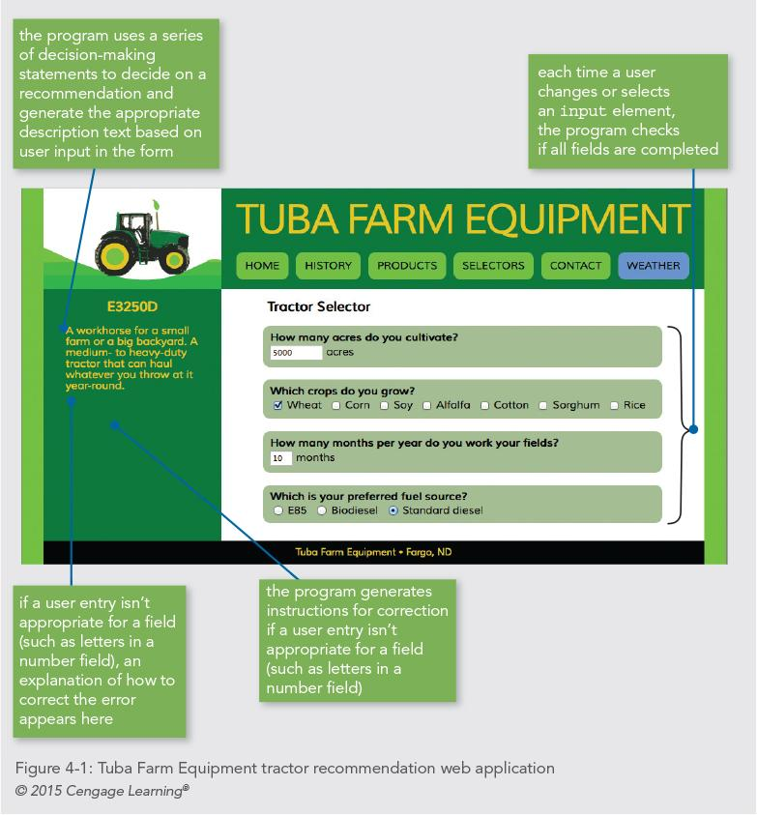
Introduction to Debugging
Programming Exercise 01_04_01 – Step 1

Slide 9
Interpreting Error Messages
Browser Console
First line of defense when interpreter encounters either syntax or run-time errors
Logic errors require other techniques
Browsers are different, we will use Chrome for our examples
Look for document, line number, and description

Slide 10
Interpreting Error Messages
Browser Console
Fixing one error does not always solve the problem
Browser interpreters often cannot reliably parse code following an error
Browsers do not strictly enforce JavaScript syntax
Not always accurate, just an indicator
JSLint
If your IDE has a good plugin, get it and use it

Slide 11
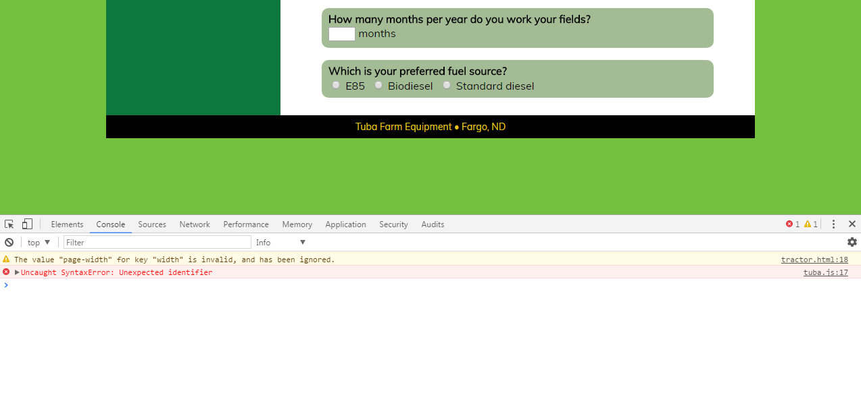
Interpreting Error Messages
Programming Exercise 01_04_01 – Step 2

Slide 12
Basic Debugging Techniques
Common Techniques
window.alert() method
console.log() method
Comments to block executable lines

Slide 13
Basic Debugging Techniques
window.alert() method
Tracing: examining statements in an executing program
Place alert() at different points within the program
Used to display variable or array contents or value returned from a function
Make use of multiple alert() methods
Check values as code executes
Watch for changes

Slide 14
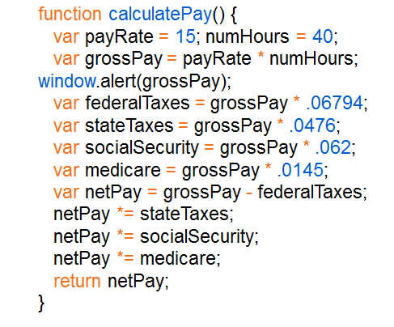
Basic Debugging Techniques
window.alert() method

Slide 15
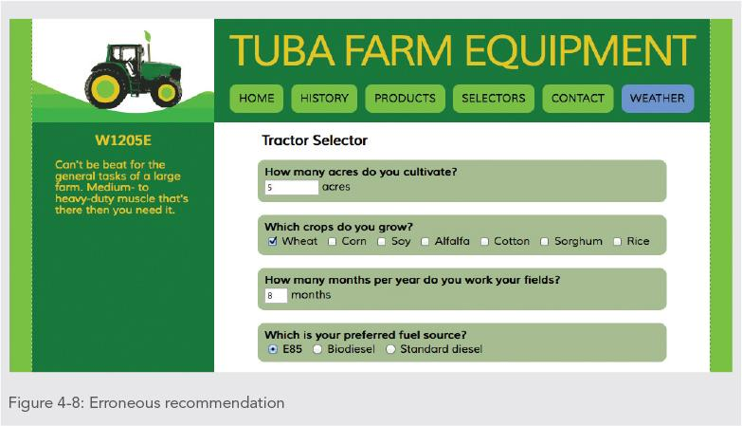
Basic Debugging Techniques
Programming Exercise 01_04_01 – Step 3

Slide 16
Basic Debugging Techniques
console.log() method
Logging: writing values directly to the console using the console.log() method
Trace a bug by analyzing a list of values
Syntax: console.log(value);
Can log string literal, variable value, or combination
Make use of multiple console.log() methods
Check values as code executes
Watch for changes

Slide 17
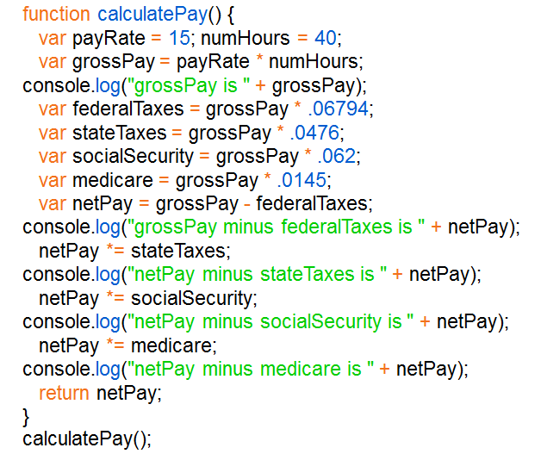
Basic Debugging Techniques
console.log() method

Slide 18

Basic Debugging Techniques
Programming Exercise 01_04_01 – Step 4

Slide 19
Basic Debugging Techniques
Using Comments to Locate Bugs
Comment out problematic lines
Helps isolate statement causing the error
Start by commenting out only the statement specified by the line number in the error message
Continue commenting lines until errors eliminated

Slide 20
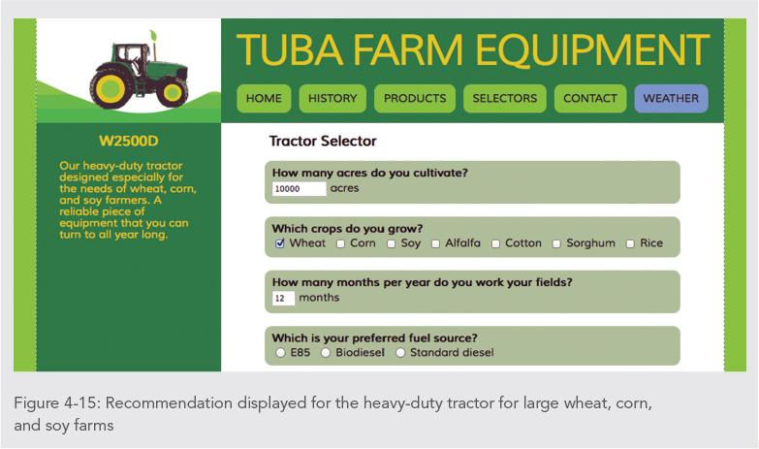
Basic Debugging Techniques
Programming Exercise 01_04_01 – Step 5

Slide 21
Using Debugging Tools
Available in all modern browsers
Accessible through same panel that opens the console
Used to examine code manually
Usually first step taken with a logic error
Works fine with smaller programs
Debugging tools
Help trace each line of code
More efficient method of finding and resolving logic errors

Slide 22
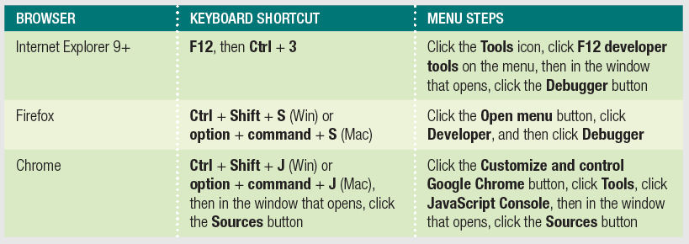
Using Debugging Tools
Using Debugger Windows
Open a document to debug in a browser
Use keyboard shortcut or menu to open debugger

Slide 23
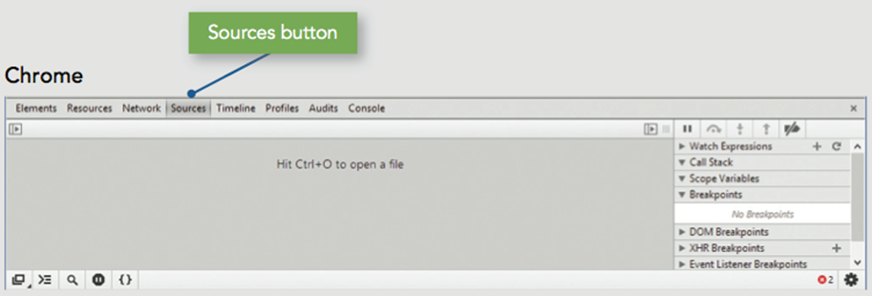
Using Debugging Tools
Programming Exercise 01_04_01 – Step 6
Setting Breakpoints

Slide 24
Using Debugging Tools
Stepping Through Scripts
Stepping into
Executes an individual line of code
Pauses until instructed to continue
Debugger stops at each line within every function
Stepping over
Allows skipping of function calls
Program still executes function stepped over
Stepping out
Executes all remaining code in the current function
Debugger stops at next statement in the calling function

Slide 25
Using Debugging Tools
Programming Exercise 01_04_01 – Step 7
Stepping Through Scripts

Slide 26

Using Debugging Tools
Tracing Variables and Expressions
Variables list
Displays all local variables within the currently executing function
Shows how different values in the currently executing function affect program execution
Watch list
Allows skipping of function calls
Program still executes function stepped over
Chrome displayed by default on right side of pane

Slide 27
Using Debugging Tools
Programming Exercise 01_04_01 – Step 8
Tracing Variables and Expressions

Slide 28
Using Debugging Tools
Examining the Call Stack
Call stack or Stack Trace
Ordered lists of which procedures (functions, methods, event handlers) have been called but haven't finished executing
Each time a program calls a procedure, it is added to top of the call stack
Processor must remember the order in which functions are executed
That way, chained functions can be unwound backwards as they finish
Chrome call stack list is displayed to right of code

Slide 29
Using Debugging Tools
Programming Exercise 01_04_01 – Step 9
Examining the Call Stack

Slide 30
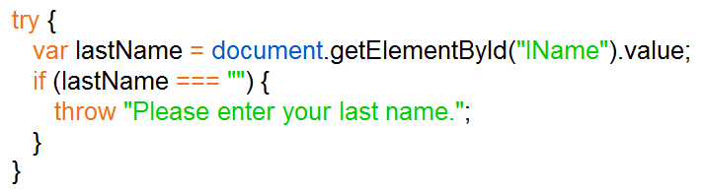
Handling Exceptions and Errors
Throwing Exceptions
Execute code containing an exception in a try statement
throw statement
Specifies an error message for an error that occurs within a try block

Slide 31
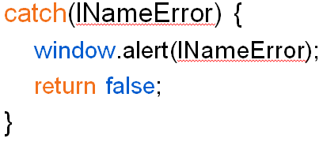
Handling Exceptions and Errors
Catching Exceptions
Use a catch statement
Handles, or “catches” the error
Syntax:
catch(error) { statements; }

Slide 32
Handling Exceptions and Errors
Executing Final Exception Handling Tasks
Executes regardless of whether its associated try block throws an exception
Used to perform some type of cleanup
Or any necessary or desired tasks after code evaluated with a try statement

Slide 33
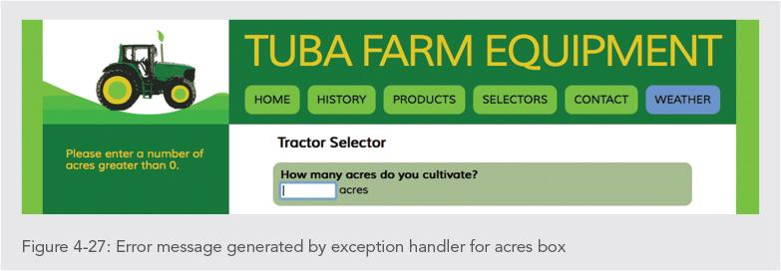
Using Debugging Tools
Programming Exercise 01_04_01 – Step 10
Exception Handling

Slide 34
Additional Debugging Techniques
Strategies
Checking HTML elements
Analyzing logic
Testing statements with console command line
Using the debugger statement
Executing code in strict mode
Linting
Reloading a Web page

Slide 35
Additional Debugging Techniques
Checking HTML Elements
If a bug cannot be located using previous methods:
Perform a line-by-line analysis of the HTML code
Ensure all necessary opening and closing tags included
Use a code editor specialized for web development
Highlights syntax errors as you type
Use the W3C Markup Validation Service to validate a Web page
https://validator.w3.org

Slide 36
Additional Debugging Techniques
Using the debugger Statement
When you include the debugger statement in your code
Web browser stops executing JavaScript code when it reaches the debugger statement
Equivalent of a breakpoint that's part of your JavaScript code

Slide 37
Additional Debugging Techniques
Using strict Mode
Removes some features from JavaScript
Requires more stringent syntax for other features
Example: must always use var to declare variables
Many removed or altered features in strict mode are known to cause hard to find bugs
Include statement "use strict";
Including at start of script section requests strict mode for all code in that section
Including at start of code block in function requests strict mode just for that function

Slide 38
Additional Debugging Techniques
Linting
Running code through a program that flags some common issues that may affect code quality
JSLint is a commonly used linting program
Similar result to using strict mode, but generates a report containing line numbers
Both Atom and Brackets have JSLint capabilities and plugins

